Slide 1


COVID-19 DATA ANALYSIS
The purpose of this project is to Analyze Covid19 Data to Gain Major Insights into trends, Patterns , And Factors Influencing the testing and vaccination during the panedemic.
ABHILASH DESHMUKH
BHAVNA NAYAK
SHIVANSH SHARMA
ROHAN PATIL
SOURABH KUMAR ROOJ

Slide 2

INTRODUCTION
Our dataset comprises comprehensive information on the spread of the virus, including infection rates, mortality rates, vaccination coverage, and various demographic factors. The objective of our project is to extract meaningful insights that can inform effective strategies for managing and mitigating the impact of the pandemic.
In the next few minutes, we will navigate through the intricacies of this dataset, aiming to uncover hidden trends, disparities, and potential areas for intervention. The significance of this analysis cannot be overstated, as it not only aids in understanding the current state of affairs but also lays the groundwork for evidence-based decision-making in the ongoing battle against COVID-19.
.

Slide 3


DATASET OVERVIEW
Our COVID-19 dataset encapsulates a wealth of information, encompassing global infection and mortality rates, vaccination coverage, regional demographics, and time-series data. Collected from authoritative sources, it spans various geographic regions and demographic categories. The dataset's richness allows for a nuanced exploration of the pandemic's multifaceted impacts, offering a panoramic view of the virus's trajectory. This diverse and comprehensive compilation equips us with the necessary tools to dissect patterns, identify outliers, and derive actionable insights crucial for effective public health responses and decision-making.
The major Column includes –
State Name
District Name
Confirmed Cases
Tested Cases
Vaccinated 1&2

Slide 4

METHEDOLOGY
DATA COLLECTION & CLEANING
EXTRACTION OF INSIGHTS & EDA
DATA VISUALISATION
Python facilitates advanced statistical modeling, data manipulation, and visualization through libraries like Pandas, NumPy, and Matplotlib
SQL is leveraged for efficient data querying and aggregation, ensuring seamless integration of diverse datasets.
Excel serves as a versatile tool for exploratory data analysis, pivot tables, and graphical representation , to extract meaningful insights from the COVID-19 dataset with precision and agility.

Slide 5
INSIGHT - 1
This insights refers to the TESTING RATIO between every state. And it concludes that UP has the highest ratio whereas Manipur has the lowest ratio.”The testing ratio might refer to the ratio of the number of tests conducted to the population size or the number of positive cases.”

Slide 6
INSIGHT - 2
The RECOVERY RATE typically represents the proportion of individuals who have recovered from a disease compared to the total number of confirmed cases. In this Insight the highest recovery rate was in Bihar state.

Slide 7

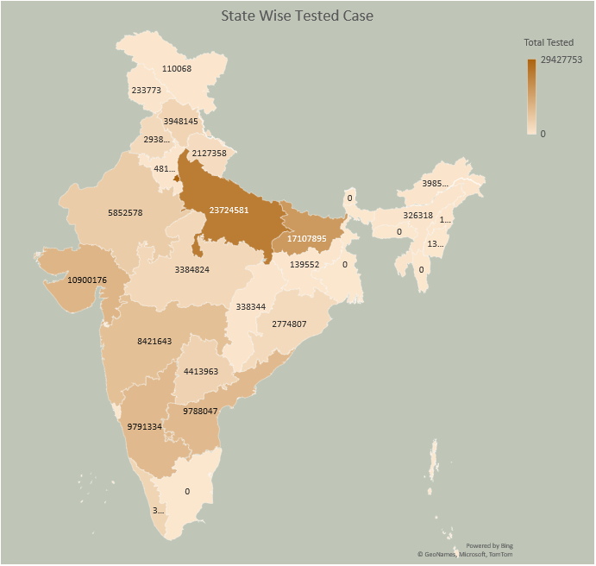
INSIGHT - 3
This Insight refers to the TESTED CASES within the country in each state. The highest tested cases was in Up state . The tested cases data doesn’t represents the confirmed cases but only the test performed by government

Slide 8

INSIGHT - 4
This insight concludes that how many deaths happened all over the country and got to know that Kerela has the highest and Lakshyadeep has the lowest in the country
This Photo by Unknown Author is licensed under CC BY-NC

Slide 9
INSIGHT - 5
This insight concludes the confirmed and recovered amongst every state in India.In which highest confirmed cases were in Maharashtra and least were in Lakshyadeep and Laddakh

Slide 10
DASH BOARD

Slide 11

CONCLUSION
In conclusion, the analysis of COVID-19 data underscores the profound impact of the pandemic on global health. The data highlights the resilience of healthcare systems, the importance of timely interventions, and the collaborative efforts of nations. As we navigate the aftermath, informed decision-making based on this data is crucial for effective future preparedness. The lessons learned from this unprecedented event serve as a foundation for building more robust and agile healthcare systems to address potential challenges ahead.
As per our analysis -
The Major impacts of deaths was in Karnataka.
The Major cases confirmed were in Maharashtra.
Manipur had the lowest & UP had the highest testing ratio.
Highest recovery rate is in Bihar state.

Slide 12


FUTURE WORK
Future work in COVID-19 data analysis could focus on several key areas to enhance our understanding of the pandemic and inform effective responses:
Predictive Modeling: Develop advanced predictive models to forecast disease spread, identify hotspots, and estimate healthcare resource needs.
Variant Analysis: Explore the impact of emerging virus variants on transmission rates, severity, and vaccine efficacy, guiding vaccine development and public health strategies.
Long-Term Effects: Investigate the long-term health effects of COVID-19 survivors, contributing to better post-recovery care and management.
Vaccination Impact: Analyze the effectiveness of vaccination campaigns, including coverage rates, vaccine breakthrough cases, and the duration of immunity.

